Slide 1



Capstone Project
SME Loan Screen:
Right First Applications

Slide 2
01
02
03
04
05
06
07
08
Table of contents
Problem
Statement
Proposed
Solution
System Architecture & Tech Stack
Mobile Extension
Key functionalities
The Workflow
09
Security Challenges
Live Demo
Conclusion &
Future Scope

Slide 3

Problem Statement:
The Challenge: Incomplete Documentation & Process Delays
1. The "Partial Submission" Bottleneck: Customers often submit incomplete document sets, preventing "Right-First-Time" processing.
2. Inefficient Screening Logic:
(a) Missing KYC: Triggers automatic rejection (High Bounce Rate).
(b) Missing Income Proof: Places application "On Hold," stalling progress.
(c) Conditional Approvals: Occur when Business Proof is missing, adding another manual step.
3. Operational Waste: Significant branch time is utilized on basic document screening rather than actual credit underwriting.
4. Customer Friction: Unclear eligibility parameters and checklists lead to avoidable rejections.

Slide 4
Proposed Solution:
The "Right-First-Time" Pre-screening Portal
Role-Based Portal: Distinct interfaces for Applicants (to apply & track) and Bank Staff (to verify & approve).
Automated Logic Engine:
  Eligibility Check: Instantly validates Turnover and Business Age before document upload.
  Mandatory Gates: Prevents submission until all required proofs (KYC, Income, Business) are present.
Smart Document Management: Integrated preview, verification, and rejection workflow.
Real-Time Communication: In-app messaging system to resolve queries instantly.

Slide 5
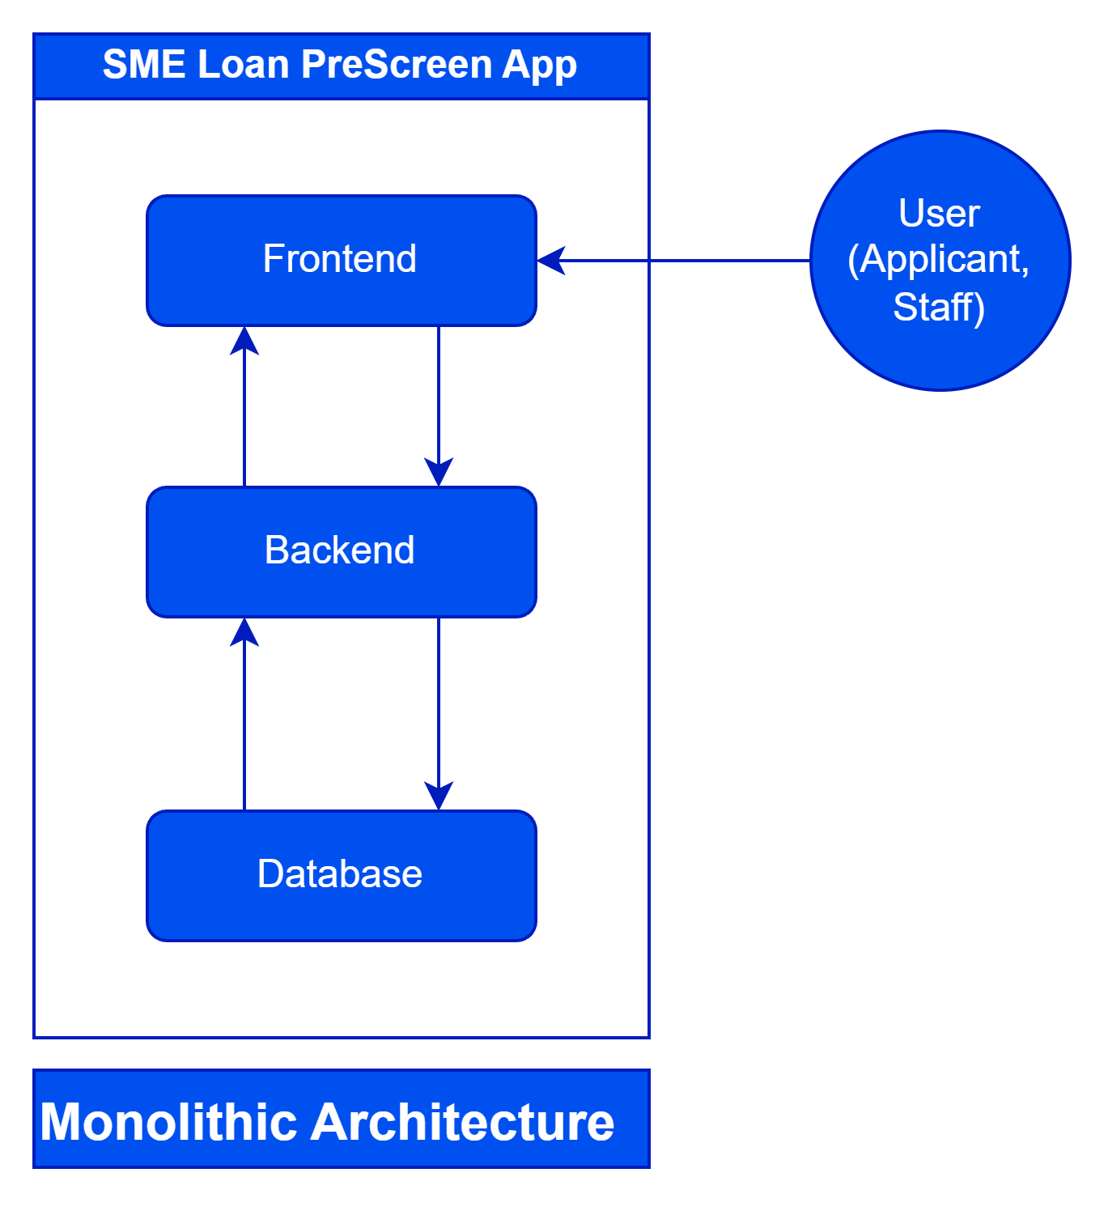
System Architecture & Tech Stack:
Frontend (Client):
  React 18 (Vite): High-performance UI.
  Tailwind CSS: For responsive, modern styling.
  Axios: For API communication.
Backend (Server):
  Spring Boot 3.3 (Java 21): Robust REST API architecture.
  Spring Security + JWT: Stateless authentication and authorization.
Database:
  PostgreSQL / H2: Relational data storage for users and applications.

Slide 6
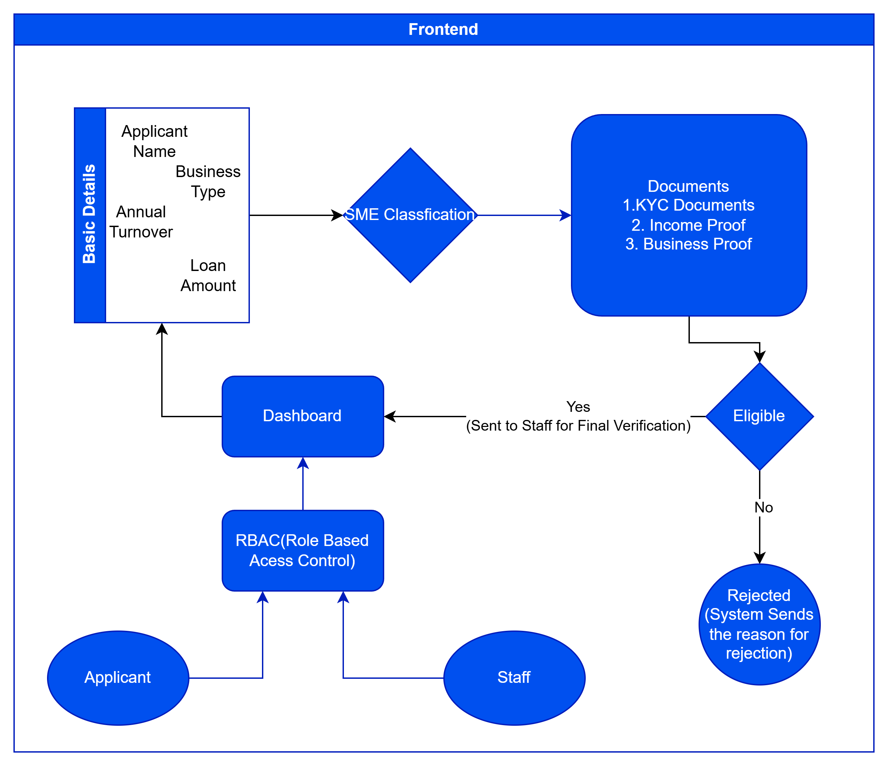
System Architecture & Tech Stack:

Slide 7
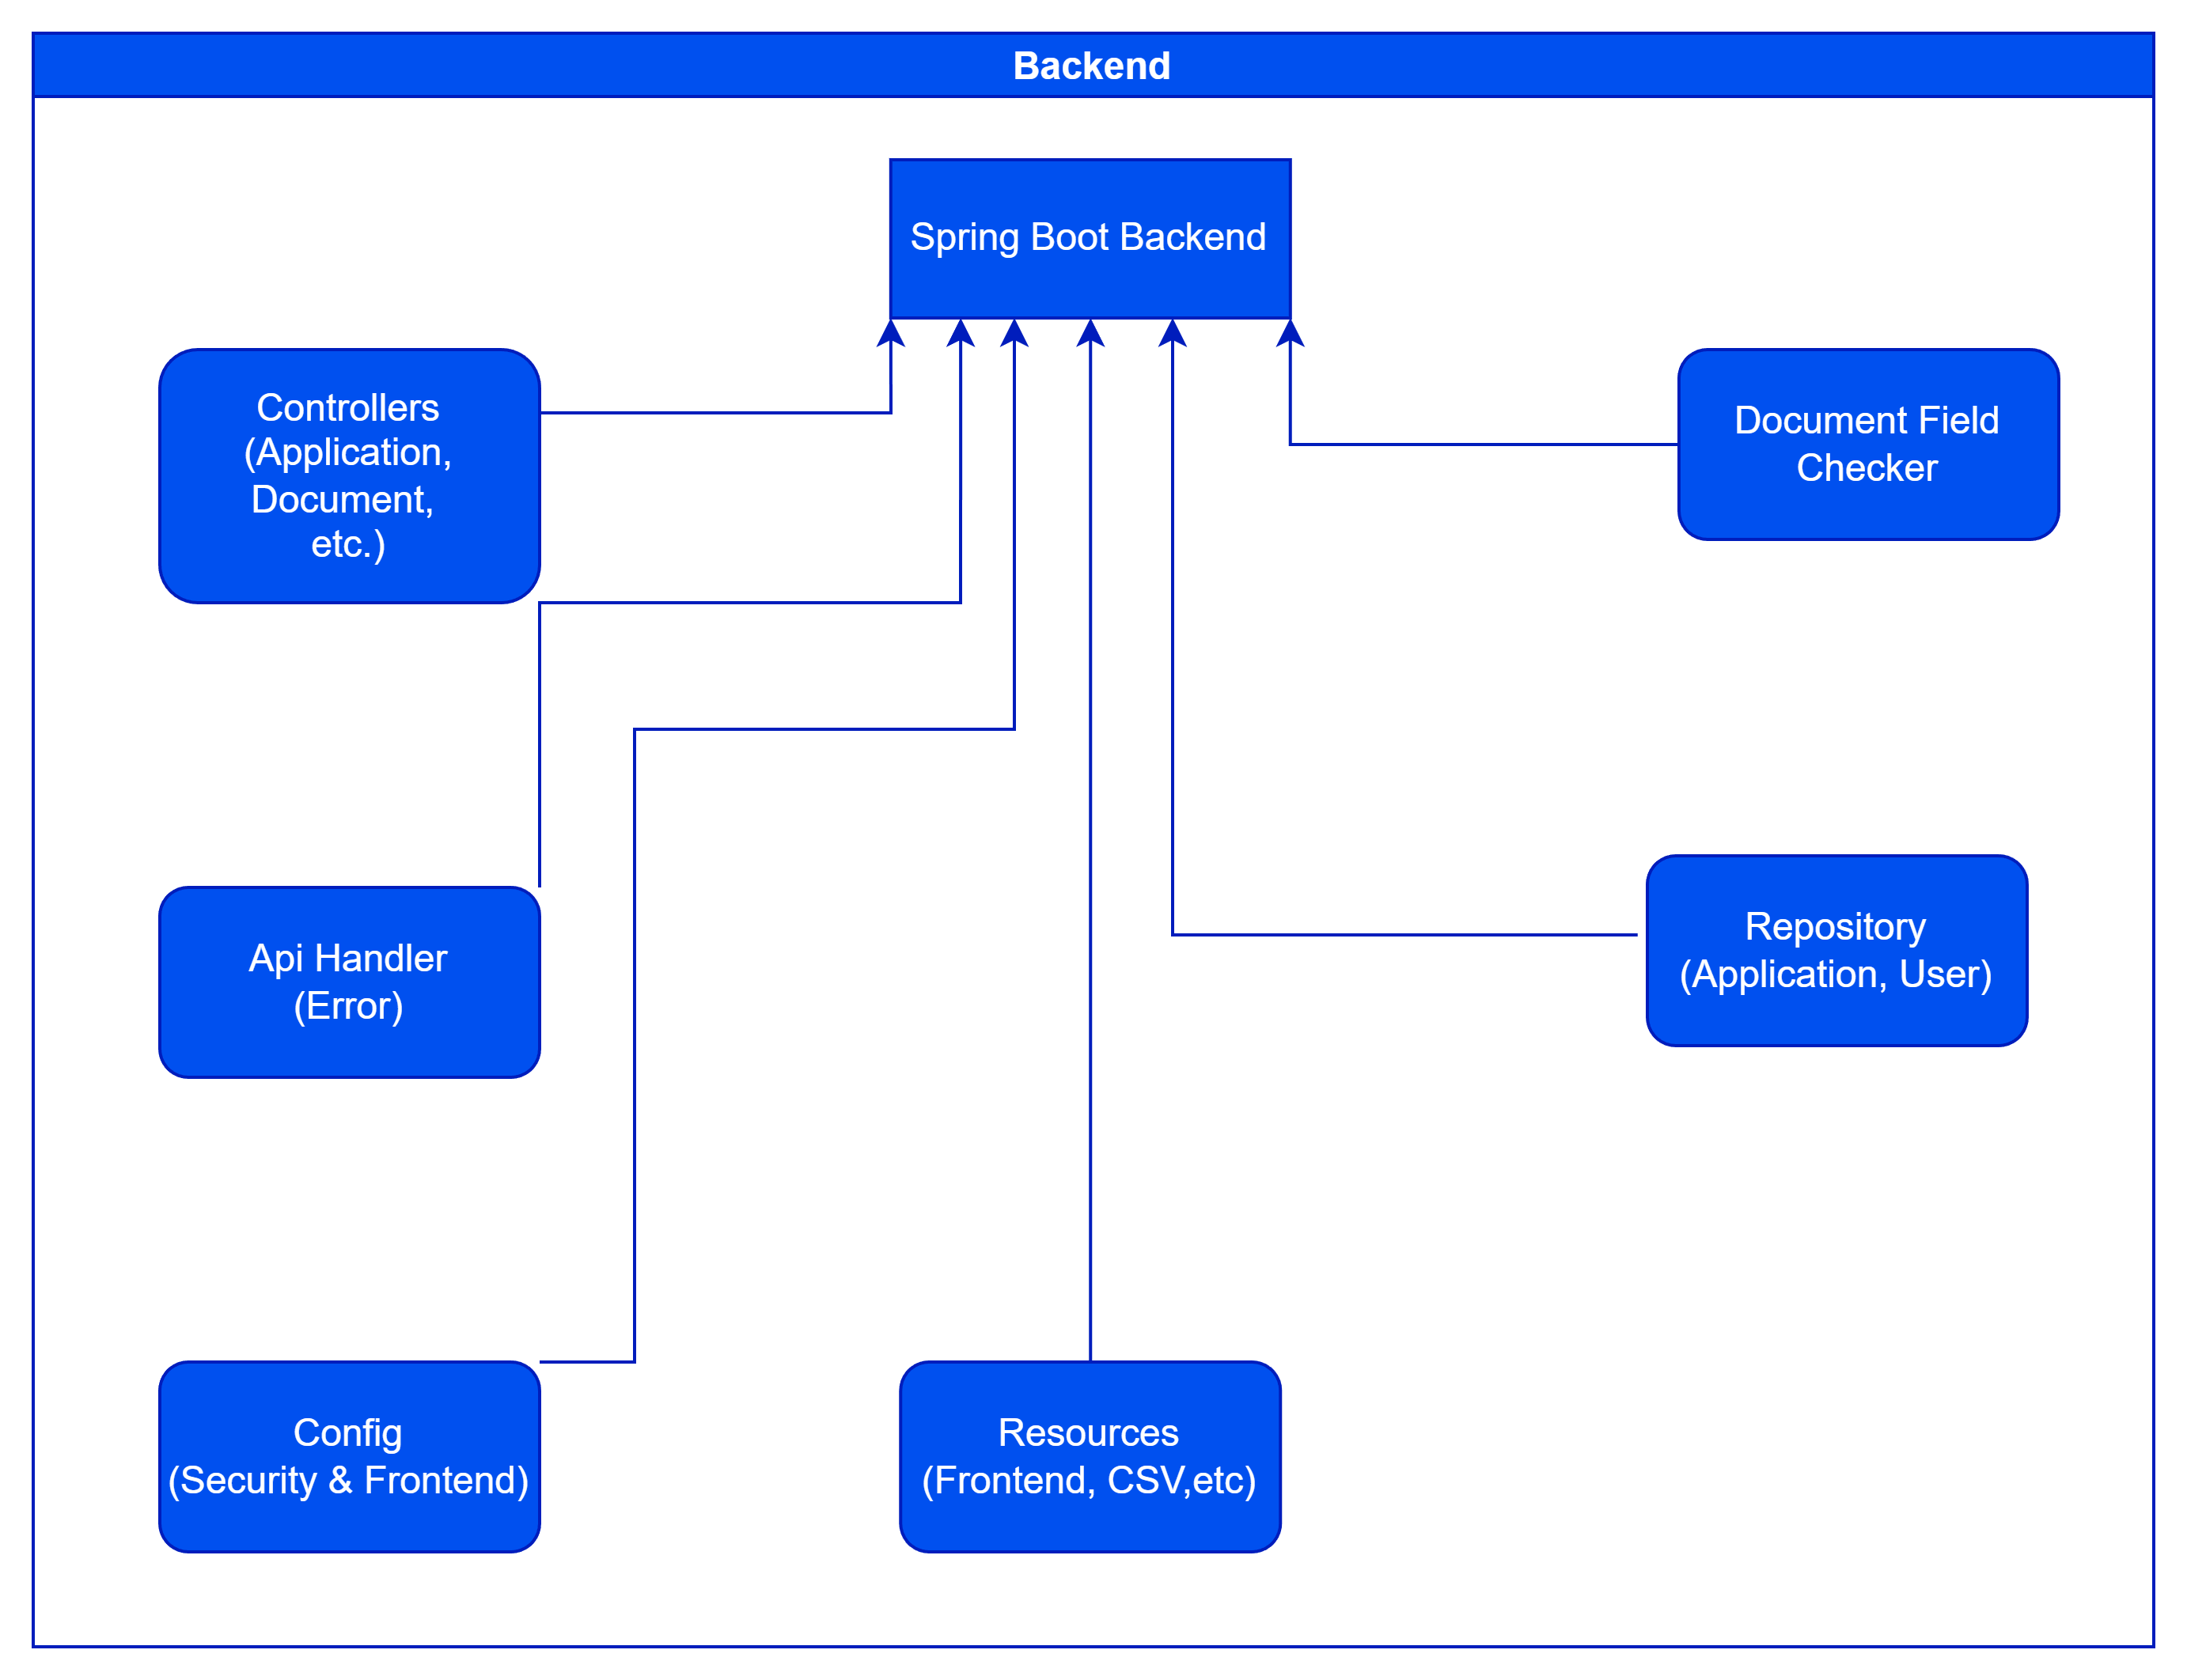
System Architecture & Tech Stack:

Slide 8
Mobile Extension(Android App):
Mobile Accessibility for both SME Owners and Bank Staff
1. Why Android?: SME owners are often on the field and need to apply or track status on the go.
2. WebView Implementation:
(a) Zero-Latency Updates: Changes deployed to the web server are instantly reflected in the app without requiring Play Store updates.
(b) Native Feel: Runs fullscreen without browser address bars for an immersive experience.
3. Key Mobile Features:
(a) Camera Integration: Users can snap photos of documents and upload them directly via the web interface.
(b) Persistent Access: One-tap access from the home screen.

Slide 9
Key Functionalities:
Core System Features:
1. RBAC (Role-Based Access Control):
  Applicants: Create requests, upload docs, view status.
  Staff: View queue, verify specific documents, final appraisal decision.
2. Document Verification System:
  Staff can preview PDFs/Images directly in the browser.
  Individual documents can be marked VERIFIED or REJECTED with comments.

Slide 10
The Workflow:
End-to-End Application Flow:
Application Creation: User inputs Turnover, Loan Amount, and Business Type.
Auto-Eligibility Check: System immediately calculates status (PENDING vs. INELIGIBLE).
Document Upload: User uploads mandatory proofs (PAN, ITR, Balance Sheets).
Staff Review: Bank Staff logs in -> Previews Docs -> Verifies Consistency.
Final Decision: System auto-updates status to READY FOR APPRAISAL only when all docs are verified

Slide 11
Security Measures:
Security & Compliance:
Authentication: JSON Web Tokens (JWT) for secure, stateless API access.
Data Protection:
  BCrypt Hashing: Passwords are encrypted before storage; never stored in plain text.
Access Control:
  CORS Configuration: API restricts access to authorized frontend domains only.
  File Validation: Backend checks to ensure only valid document formats are uploaded.

Slide 12

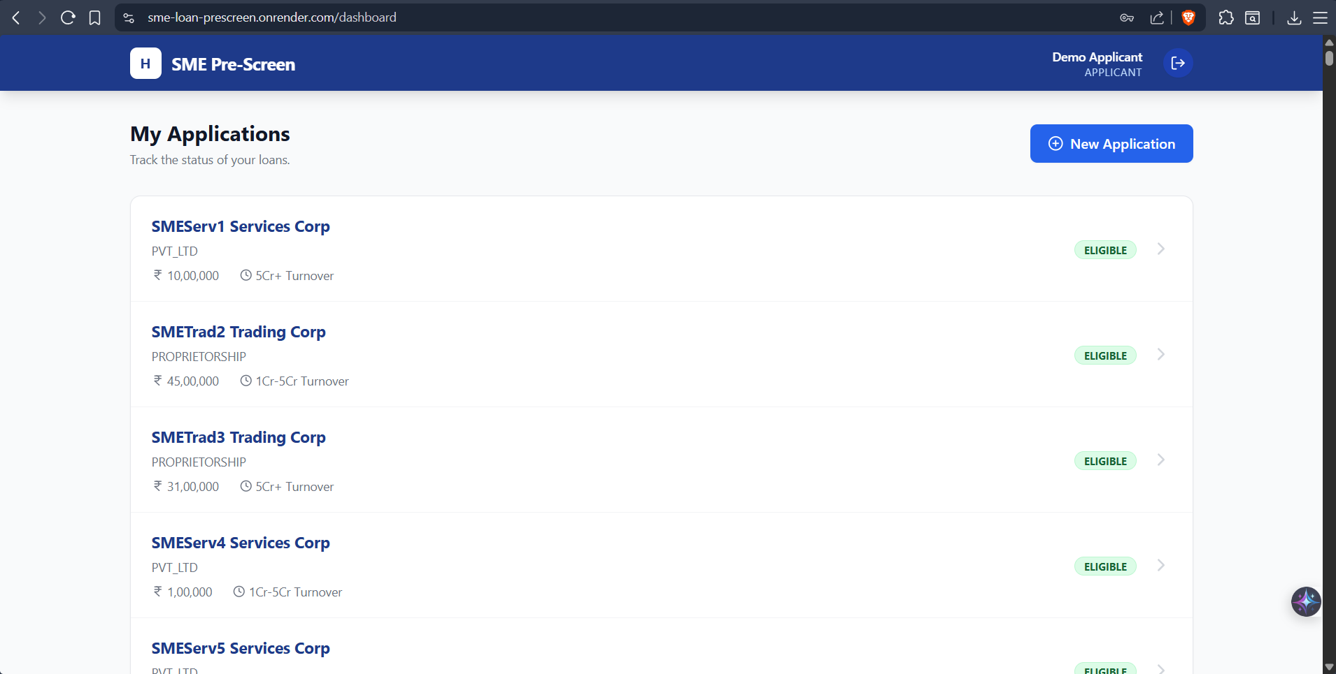
Live Demo :
Demonstration Setup:
Demo Data: System pre-loaded with comprehensive test cases.
Applicant Role:
  ID: APPLICANT-DEMO
  Action: Create App, Upload Docs, Chat.
User Dashboard Screen

Slide 13
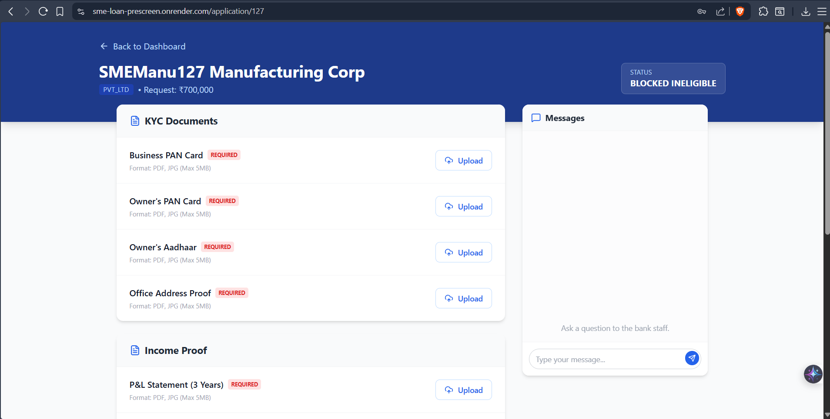
Live Demo :
Demonstration Setup:
Demo Data: System pre-loaded with comprehensive test cases.
Applicant Role:
  ID: APPLICANT-DEMO
  Action: Create App, Upload Docs, Chat.
Document Upload Screen

Slide 14
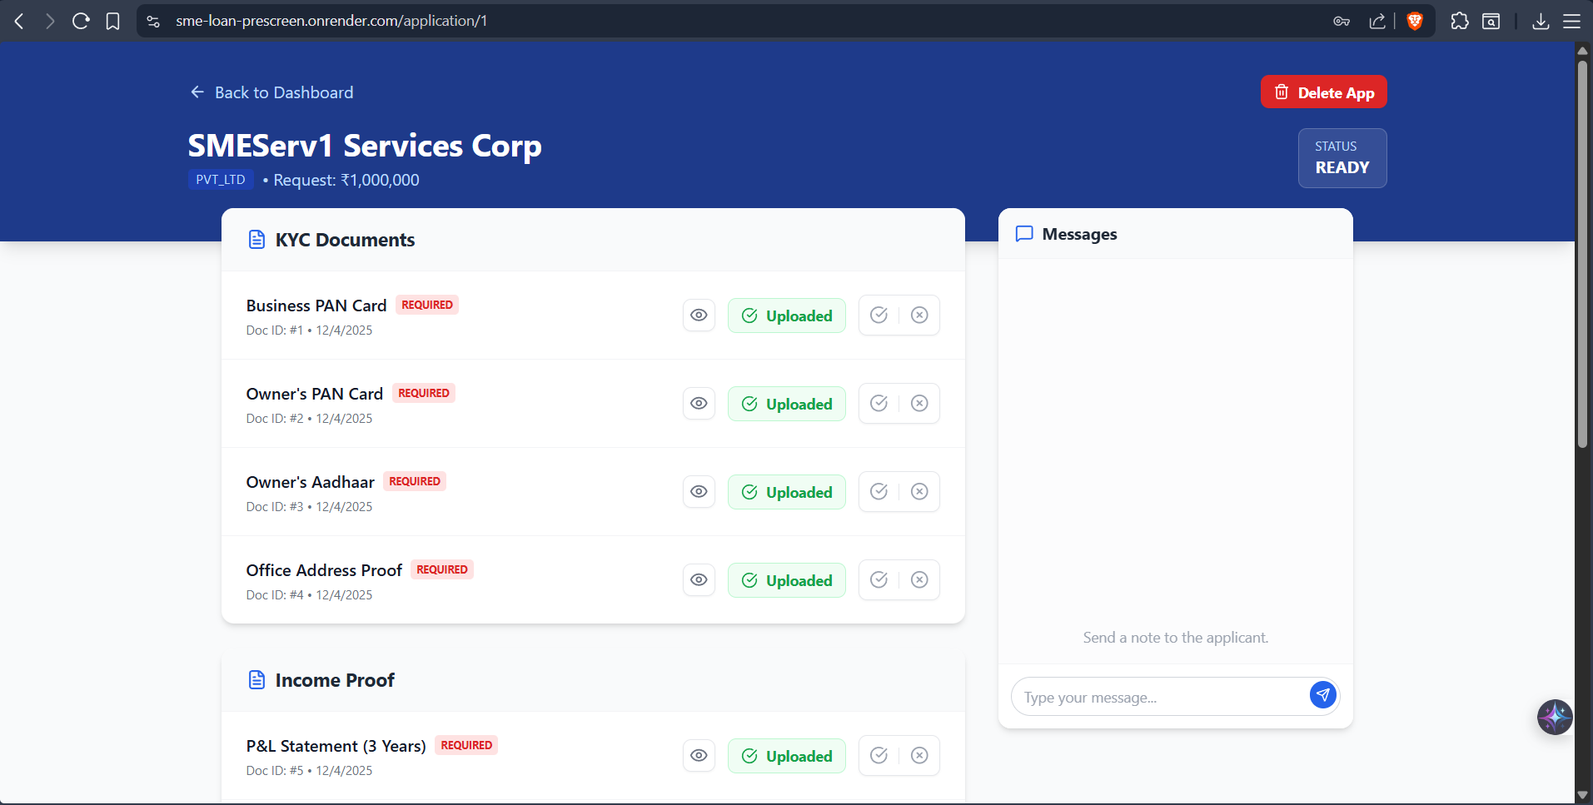
Live Demo :
Demonstration Setup:
Bank Staff Role:
  ID: STAFF-1
  Action: Review Queue, Verify Docs, Approve/Reject
Bank Staff Application Review Screen

Slide 15

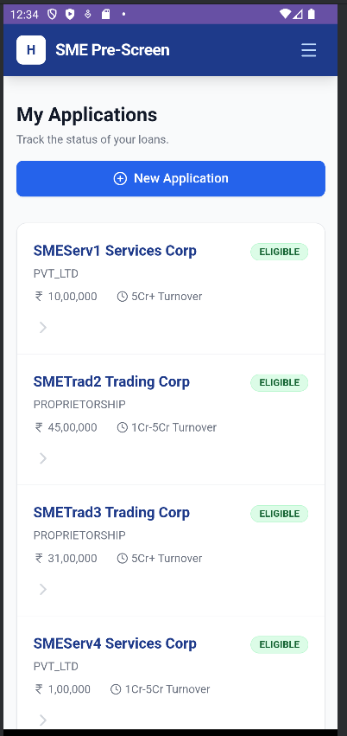
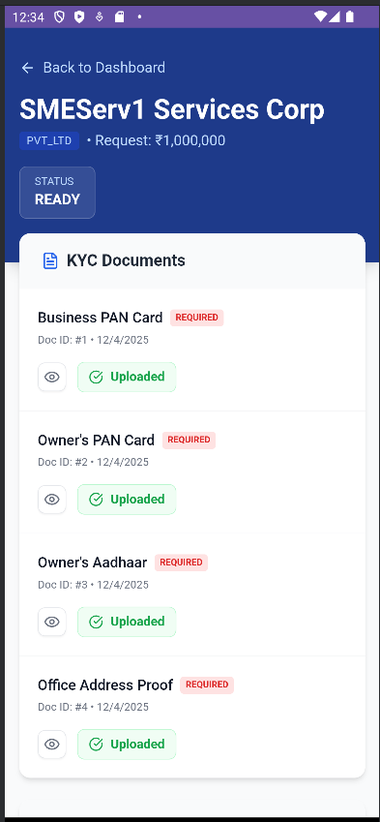
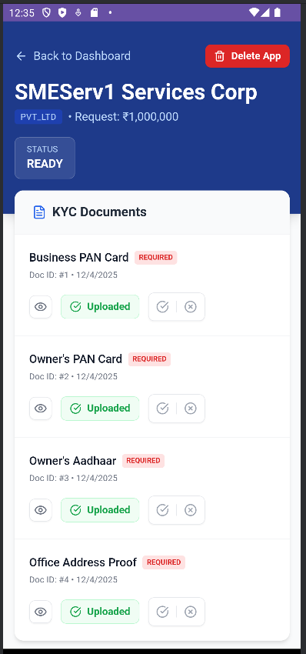
Live Demo :
Demonstration Setup:
Android Application Screen

Slide 16
Conclusion & Future Scope:
Impact & Future Roadmap
Impact:
Eliminate “incomplete” applications reaching the credit desk.
Reduces turnaround time by digitizing document verification.
Future Scope:
OCR Integration: Automatically extract data from uploaded documents.
Cross Platform App: Full Fledged-App for both Android & IOS devices.
API Integration: Auto fetch details of the applicant (Aadhar Card, PAN ,etc.) with permissions from the respective databases.

Slide 17
THANK YOU
Website Link: https://sme-loan-prescreen.onrender.com/
*the website takes some time to load due to inactivity so wait for some time.

